Slide 1
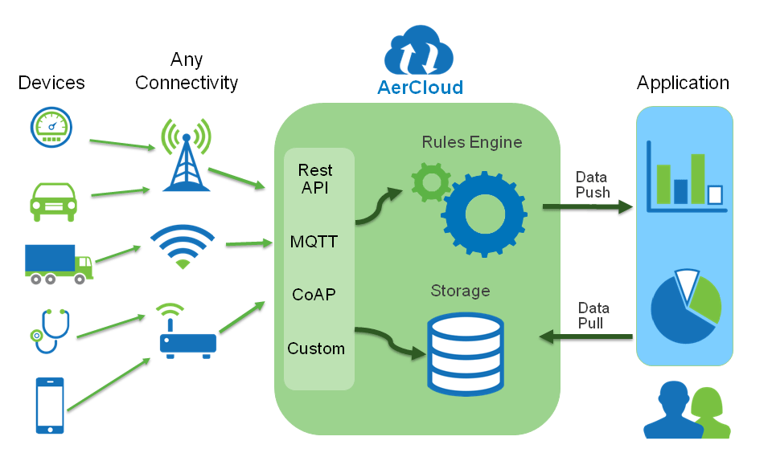
IoT Platforms
This Photo by Unknown Author is licensed under CC BY-SA-NC
Frank Walsh

Slide 2
What are IoT platforms
IoT applications combine sensors, devices, data, analytics and integrations in a seamless and unified way
e.g. your project!
IoT Platforms provide software tools and components to:
connect sensors, devices, and data networks
Analyse and store data
Integrate with other apps
Main selling point of an IoT platform is software that it
accelerates the IoT development process
Focuses on IoT: brings in best of breed features
Provides initial scaffolding for IoT projects

Slide 3

What are IoT Platform
Many(not all) are cloud-based platforms that require subscription
Provide device/language agnostic set of Software Development kits
Arduino/Rpi/others
IoT development is generally iterative:
Starts with initial simple use case
Once operational, data/insights result in new usecased
IoT platforms should promote scalable, iterative development
Allow for quick app development
Ability to adapt/optimise apps quickly

Slide 4
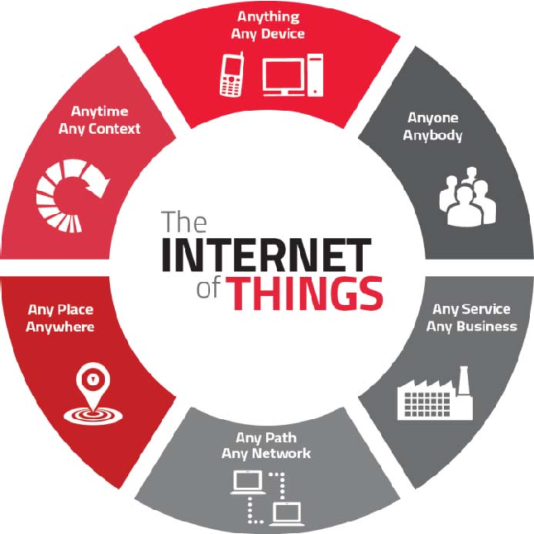
IoT Platform Characteristics
Manage many concurrent device connections
Connectivity across several connection types
"Off-the-peg" IoT protocol stack
Manage/analyse/visualise data
Integrations to other services/apps
App Development

Slide 5

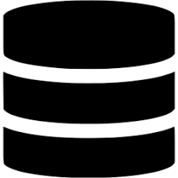






IoT Platform – generalised
Configure analytics/visuals/apps
Data/commands
IoT Platform
Deploy program to devices

Slide 6
IoT Platform Advantages
Use sofware component that has been pre-built and pre-tested. This increases the reliability of your application and reduces development effort.
IoT frameworks constantly evolve, providing new features, integrations etc.
Encourages better "design pattern" for your IoT app.
Predefined APIs and docs
Great for collaboration
"Baked-in" standards and features:
Security, authentication, scalability...

Slide 7

Which one?
Connectivity
Does the platform provide suitable capability and integrations (WiFi/Cellular/LPWan-Sigfox)
Maturity
In business for long? Critical mass in developer community?
Free
Is there a free tier (handy for evaluation)?
Service type
Platforms try to distinguish themselves – what specialisms/USP does it have?
Security
What security model do they use? Is there security issues reported in past?
Geographic area
Does it operate well at your location (can you select edges/data centres)

Slide 8
Thingspeak

Slide 9
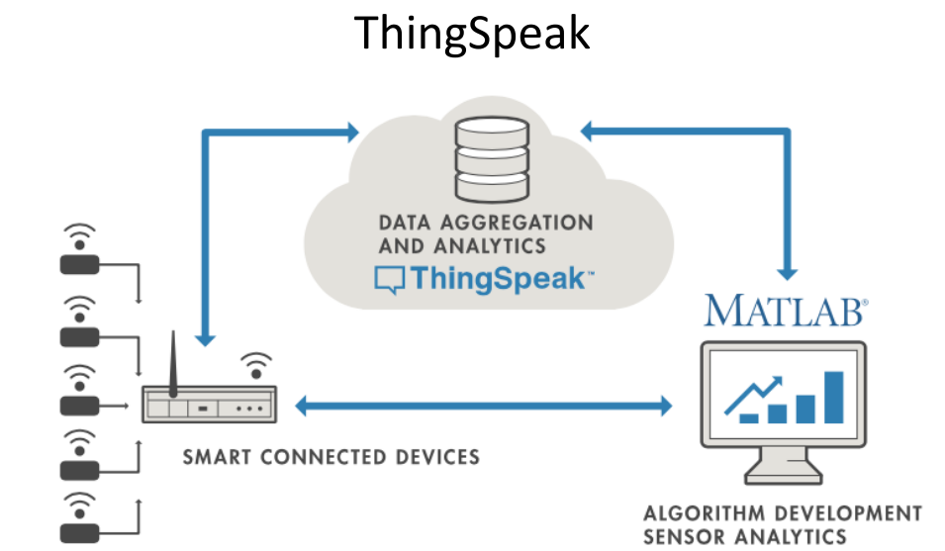
Thingspeak Overview
Account-based
Can create free account online
Brought to you by the people who made Matlab
Uses Matlab features/toolboxs
SDKs/librarys for popular languages/devices
Should work with any connected device

Slide 10
Thingspeak – basic use
Create a new channel
Test for certain conditions and perform actions
Act on the data
Run analytical algorithms/visualise your data
Analyse the data
Devices write data to channels
Collect data in the channel
Channels collect data

Slide 11
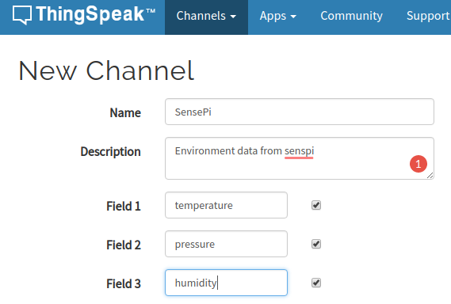
ThingSpeak – Create new channel
Create a new channel to collect data from devices
Define data fields for the channel(max 8)
Can also input location(lat/long) of channel source)

Slide 12
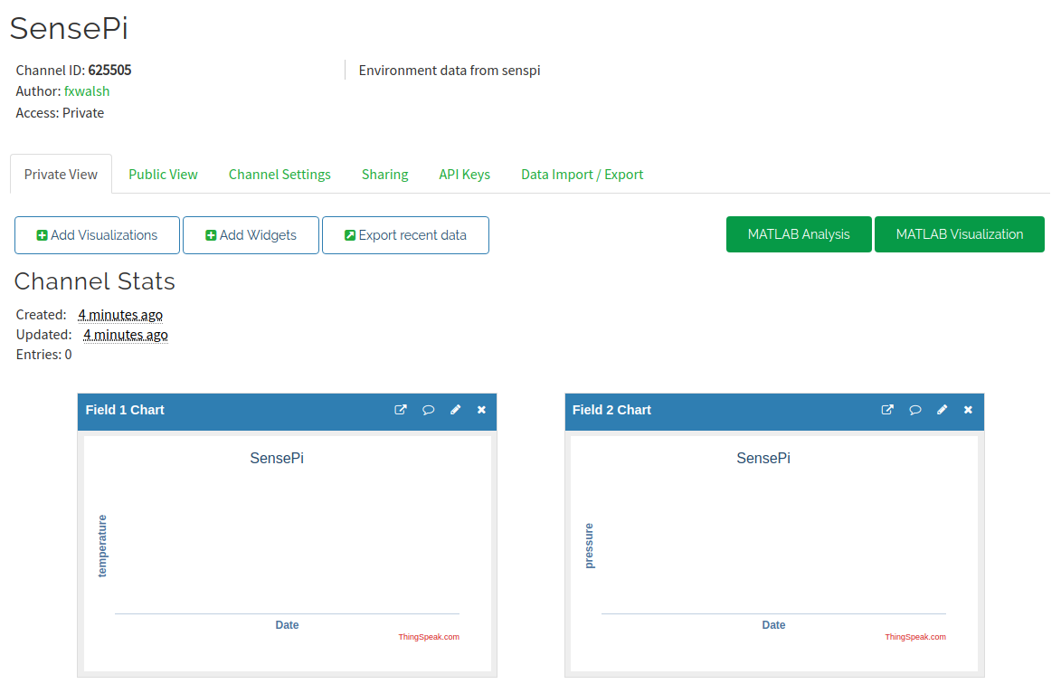
Thingspeak - New channel
Once saved you can access channel page:

Slide 13
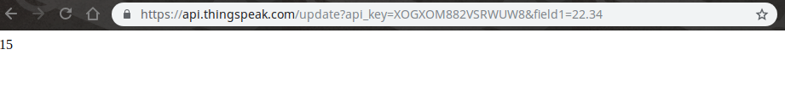
Thingspeak - Add data to channel
Programmatically, many ways!
Construct HTTP GET request and include field values in query string
GET https://api.thingspeak.com/update?api_key=<WRITE-KEY>&field1=12
Because always HTTP GET request, can test from a browser:

Slide 14
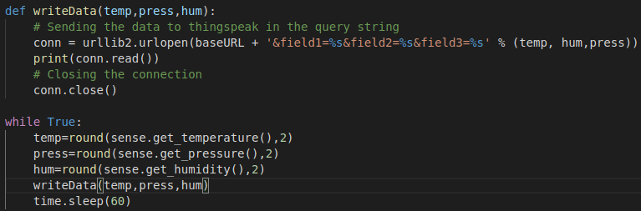
Thingspeak – Add data with python
Make HTTP request from Python:

Slide 15
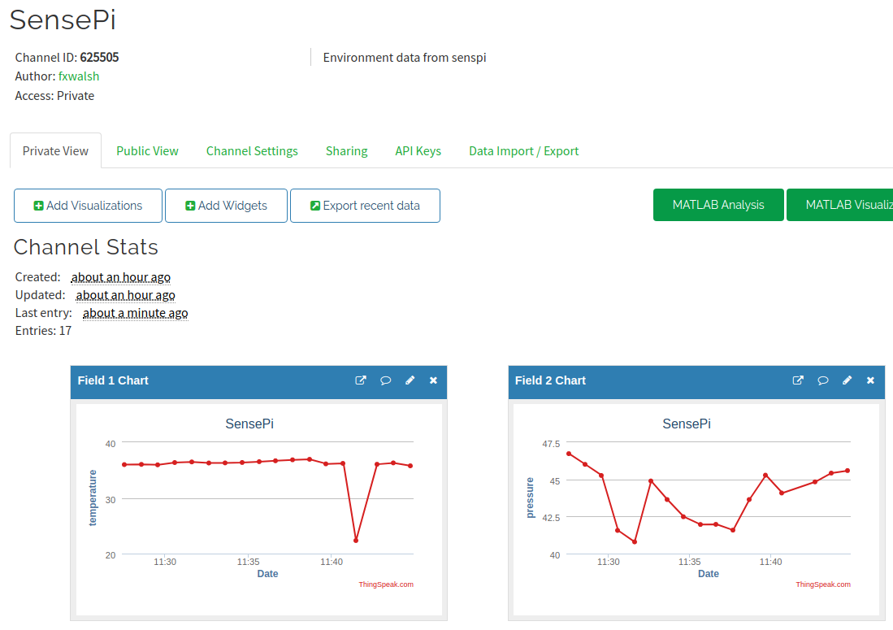
Think Speak – Analyse data
Thingspeak will visualise each field by default in channel view

Slide 16
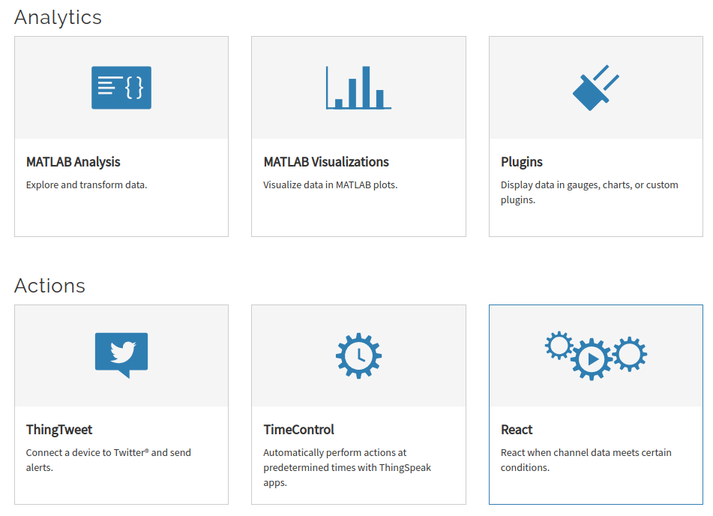
Thingspeak - Apps
The Apps tab provides various mechanism to transform, analyse,visualise and act on data.

Slide 17
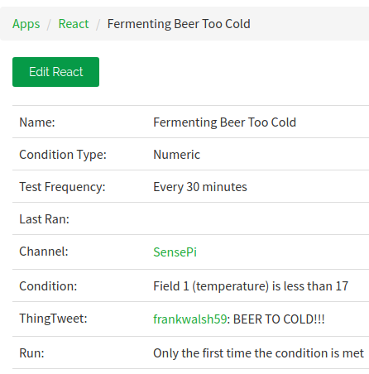
ThingSpeak Example: ThingTweet
Link Twitter account to Thingspeak
Create a React to tweet when a certain condition is met.
Also tweet from device using HTTP POST:
POST https://api.thingspeak.com/apps/thingtweet/1/statuses/update api_key=<YOUR_API_KEY> status=I just posted this from my thing!

Slide 18
ThingSpeak Example: Analysis
Can write Matlab Code to analyse and transform data
Possible uses:
Clean data (remove “outliers”)
Statistical analysis
Transfomations
Data Fusion
Generally write results to second channel for further analysis/visualisation.

Slide 19
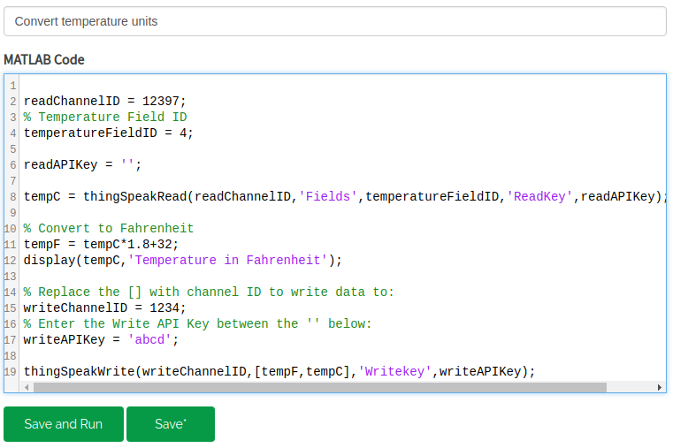
Thinkspeak: Convert Celcius to Fahrenheit

Slide 20
Other Platforms
Ubidots
Amazon Web Services
Microsoft Azure
Evothings

